Slide 1
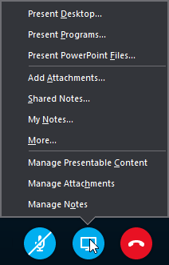

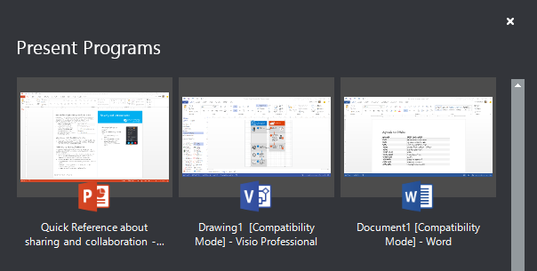
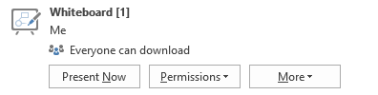
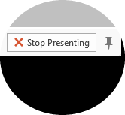
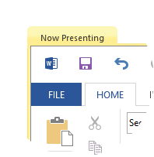
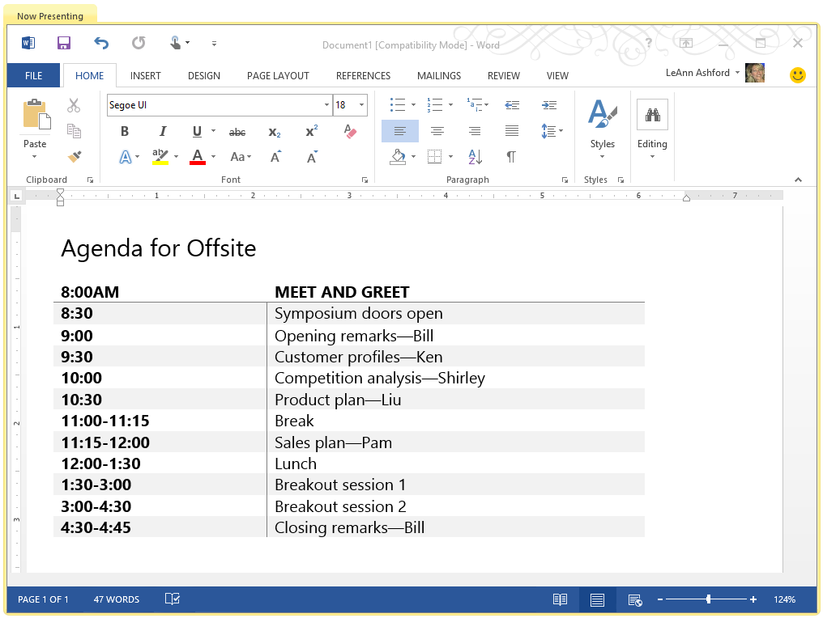
Skype for Business (Lync)
Quick Start Guide
Give control to others…
Allow others to flip through slides, contribute information, and make changes to a whiteboard or OneNote, PowerPoint or other kind of file, or demonstrate a program with just a couple of clicks. Take back control at any time.
Click Give Control.
Pick a particular person or click Give Control Automatically to automatically give access to
anyone who asks for control of your desktop.
Sharing and collaboration
Share your desktop or a program
Need to show everyone what you’re talking about?
2
In the meeting window, click the Present button.
Click Present Desktop to show the entire contents of your desktop…
or…
Click Present Programs and double-click the program you want to share.
…and, take back control
Click Give Control again.
If Give Control Automatically is selected, click it to clear it. Or to take back control from a person, click Take Back Control.
Select who can download shared files
In a scheduled meeting, you can restrict who can download a copy of a file you’re sharing—like if the information is still a draft or is confidential.
Click the Present button, and then click the Manage Presentable Content button.
Click the Permissions button, and then select from:
Double-click the program you want to share.
If you share a program, it will have a yellow border and a Now Presenting tab on your desktop.
1
3
To stop sharing, click Stop Presenting on the bar at the top of your screen, or at the top of the conversation window.
Organizer - just the person who set up the meeting
Presenters - just the people who the organizer set up as presenters
Anyone - all participants
IMPORTANT: When desktop sharing, everyone in the meeting can see your programs, files, and notifications. If you have files that you don’t want people to see, close them or use program sharing instead.
5
4
© 2015 Microsoft Corporation. All rights reserved.

Slide 2
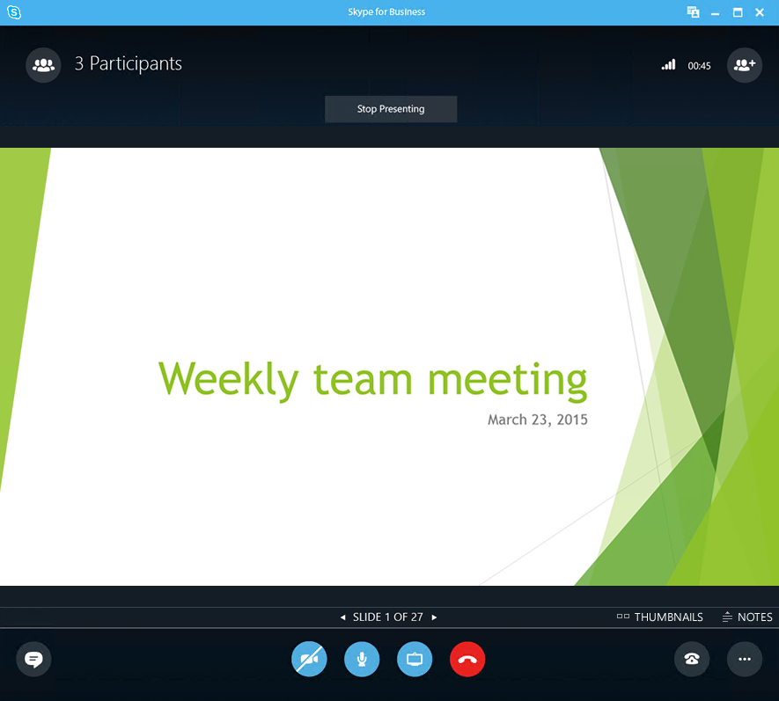
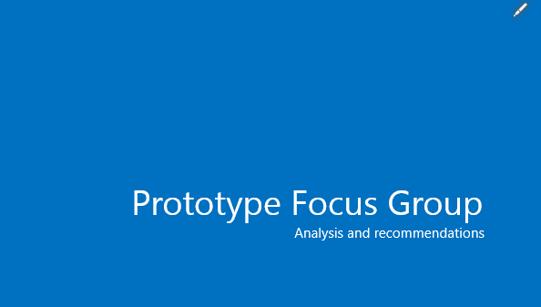
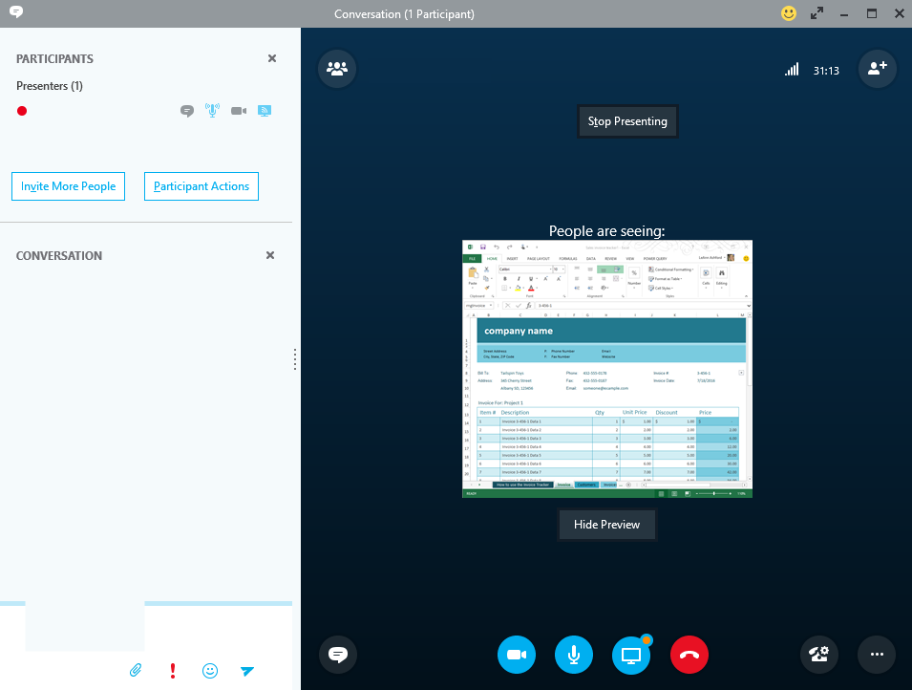
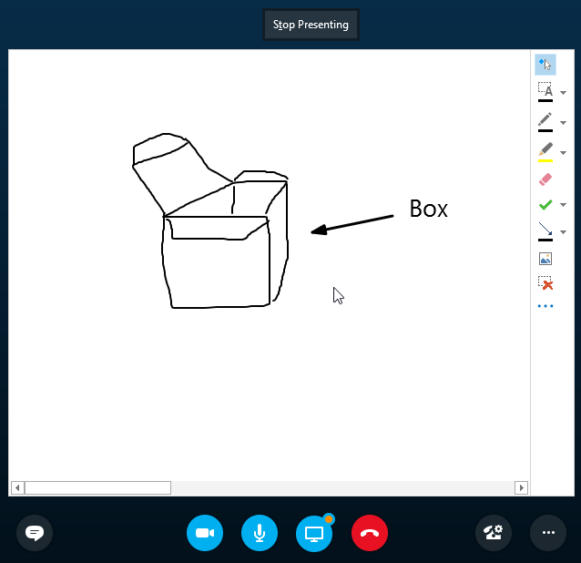
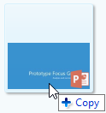
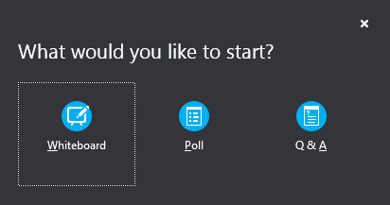
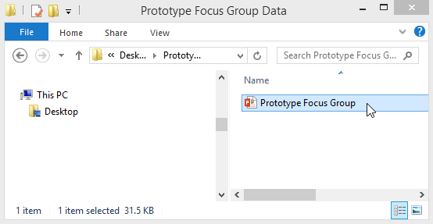
Share a PowerPoint presentation
Share notes with OneNote
OneNote is fully integrated with Skype for Business. You, or anyone you’ve given permissions to before the meeting, can have access to the OneNote file and take notes.
In the conversation window, click the Present button, and then choose Shared Notes.
Select an existing notebook, or click New Notebook to create a new one.
Participants who joined the meeting using Skype for Business are automatically added to an attendee list in the OneNote.
In the meeting window, click the Present button.
Click Present PowerPoint Files.
Browse to the file you want to present and click OK.
2
See the presenter’s notes (just you—no one else can see them)
1
Advance to the next slide
Show thumbnails of the slides, and select the next one to present
Share a whiteboard
Need to show what you’re talking about? Draw it using the Whiteboard! It’s also great for brainstorming.
In the conversation window, click the Present button, click More, and then click Whiteboard.
Check out the toolset on the right side of the whiteboard.
It’s even got a laser pointer.
Share a file or a picture
If this is a two-person impromptu meeting, the simplest way is to drag and drop—either to the IM area or to a participant’s name.
If you’re in a scheduled meeting, click the Present button, then select Add Attachment.
NOTE: Some file types (.vsd, .exe, etc.) cannot be transferred. Also, file transfers may not work when on a VPN connection.
IMPORTANT: Due to regulatory and compliance reasons, Supervised/Registered users should refrain from using the Lync whiteboard feature. Supervised users may be prevented from using specific features, which include file transfers and PowerPoint annotations.
v. 4.27.15

